Slide 1

Estudante: João Victor da Silva Guerra
Orientador: Paulo Sergio Lopes de Oliveira

Slide 2

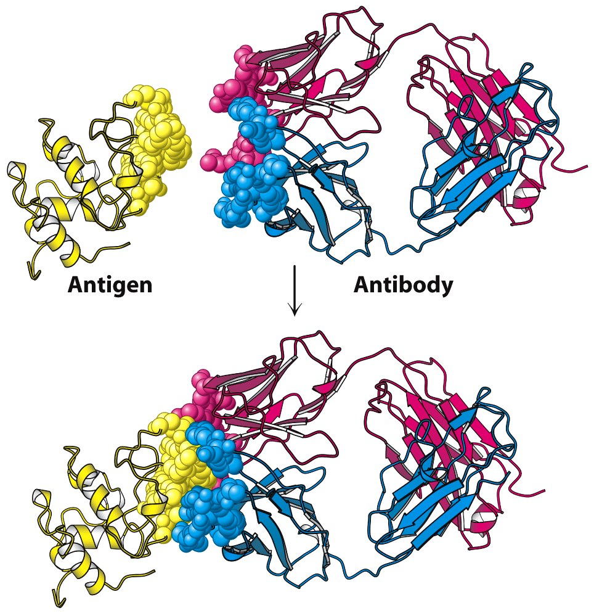
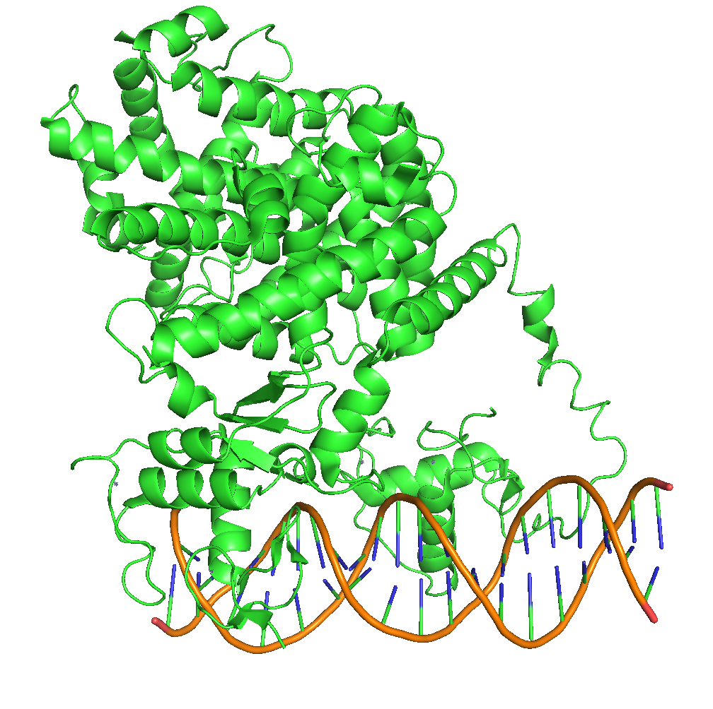
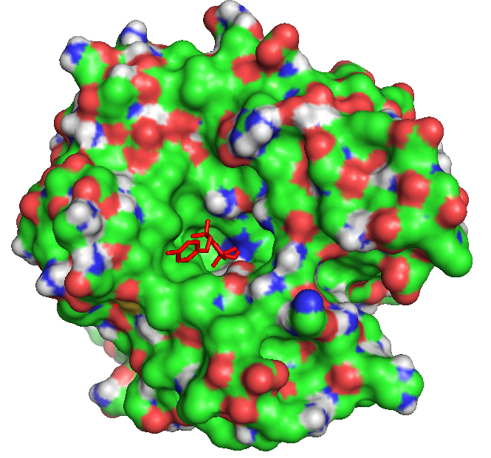
KVFinderMD: a Python package to detect and describe binding sites in molecular dynamics trajectories
Guerra, JVS; Ribeiro-Filho, HV; Bortot, LO; Jara, GE; Pereira, JGC; Lopes-de-Oliveira, PS
How do biomolecules perform their functions?
Boriack-Sjodin, P. A., Zeitlin, S. & Christianson, D. W. CARBONIC ANHYDRASE II INHIBITOR. (1999)
Berg, J. M., Tymoczko, J. L. & Stryer, L. Biochemistry. (W.H. Freeman, 2011)
PPARg-RXR complex bounded to DNA
Notes:
Biomolecular interactions dictate many biological processes, e.g., signal transduction, structural integrity, cell adhesion and apoptosis, which mainly occur by receptors interacting with other molecules, ranging from ions, e.g., iron and phosphate, to macromolecules, e.g., proteins, RNA, DNA.

Slide 3
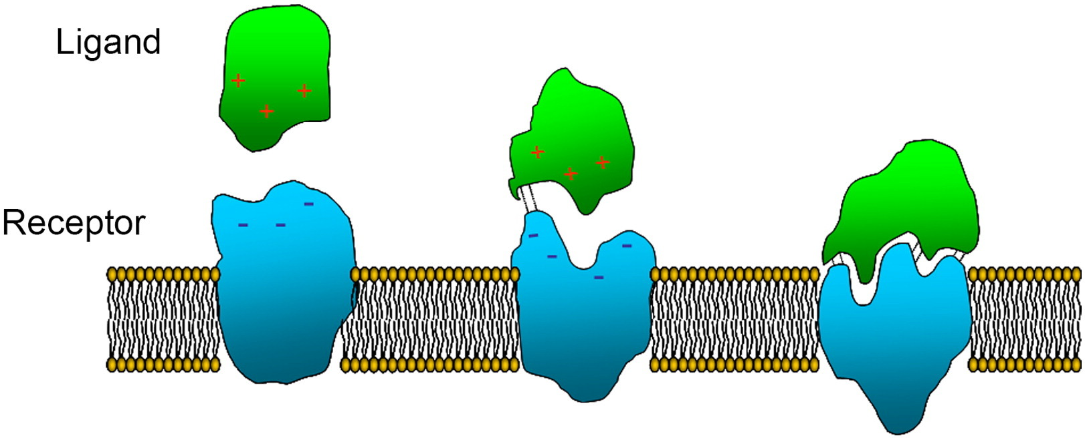
KVFinderMD: a Python package to detect and describe binding sites in molecular dynamics trajectories
Guerra, JVS; Ribeiro-Filho, HV; Bortot, LO; Jara, GE; Pereira, JGC; Lopes-de-Oliveira, PS
How do molecular interactions occur?
Guryanov, I., Fiorucci, S. & Tennikova, T. Receptor-ligand interactions: Advanced biomedical applications. Materials Science and Engineering: C vol. 68 890–903 (2016)
Notes:
These ligands generally bind in specific binding sites formed by solvent-exposed clefts or buried cavities, exposing topological and physicochemical patterns to accommodate them.

Slide 4
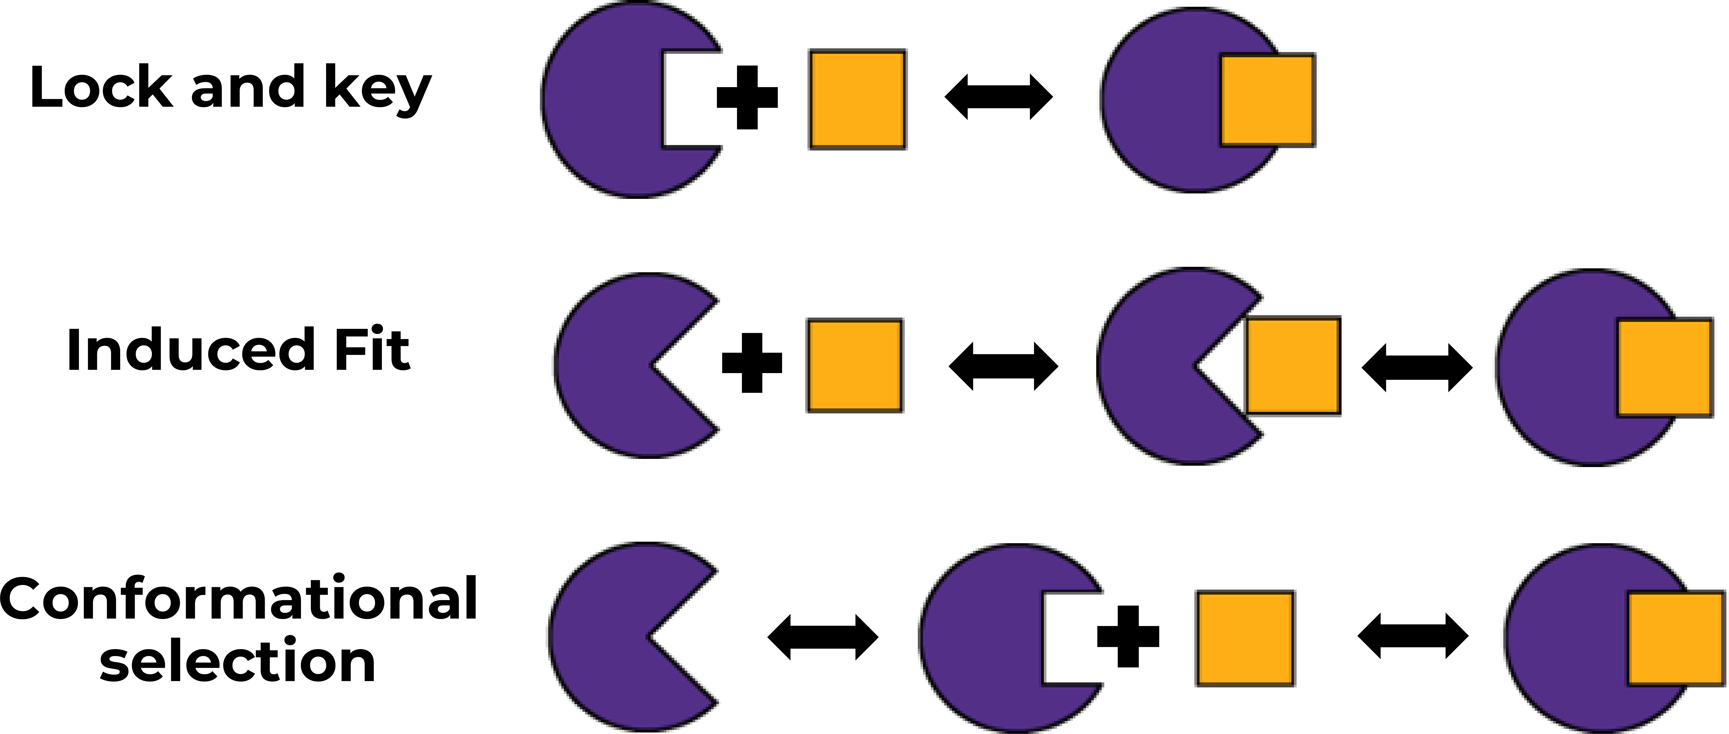
KVFinderMD: a Python package to detect and describe binding sites in molecular dynamics trajectories
Guerra, JVS; Ribeiro-Filho, HV; Bortot, LO; Jara, GE; Pereira, JGC; Lopes-de-Oliveira, PS
Substrate recognition process
Notes:
The protein-ligand and protein-protein interactions rely on the intrinsic dynamics of the target receptor, in which the classical lock and key model fails, and more recent binding models, e.g., induced-fit and conformation selection, thrive. Thus, molecular dynamics simulations are a useful tool to understand the underlying mechanisms of molecular recognition and, ultimately, the biomolecular function.

Slide 5
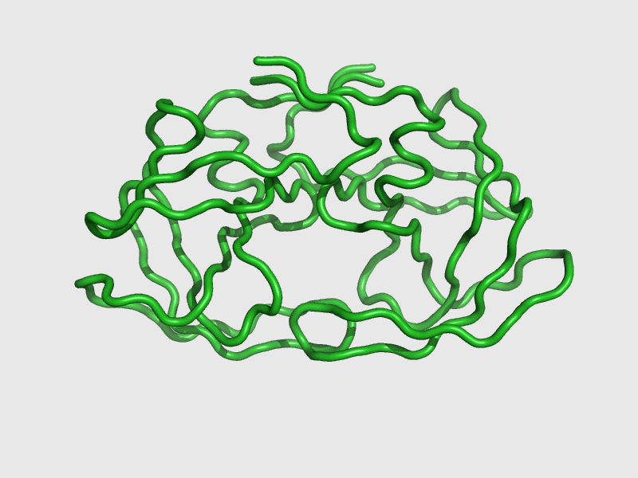
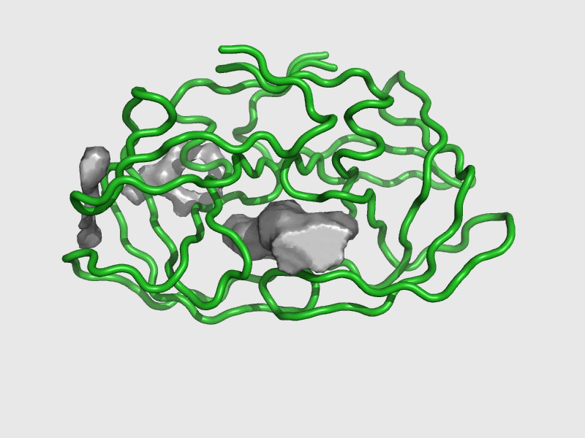
KVFinderMD: a Python package to detect and describe binding sites in molecular dynamics trajectories
Guerra, JVS; Ribeiro-Filho, HV; Bortot, LO; Jara, GE; Pereira, JGC; Lopes-de-Oliveira, PS
Molecular dynamics
Notes:
The protein-ligand and protein-protein interactions rely on the intrinsic dynamics of the target receptor, in which the classical lock and key model fails, and more recent binding models, e.g., induced-fit and conformation selection, thrive. Thus, molecular dynamics simulations are a useful tool to understand the underlying mechanisms of molecular recognition and, ultimately, the biomolecular function.

Slide 6
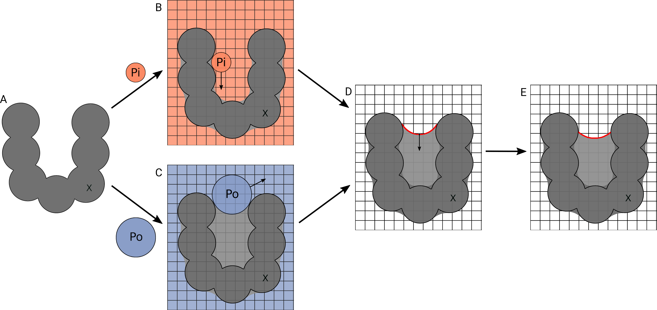
KVFinderMD: a Python package to detect and describe binding sites in molecular dynamics trajectories
Guerra, JVS; Ribeiro-Filho, HV; Bortot, LO; Jara, GE; Pereira, JGC; Lopes-de-Oliveira, PS
How to detect cavities in biomolecules?
pyKVFinder: a useful building block for developing new tools
Guerra, J. V. da S. et al. pyKVFinder: an efficient and integrable Python package for biomolecular cavity detection and characterization in data science. BMC Bioinformatics vol. 22 (2021).
Notes:
Explain how KVFinder dual probe system works.

Slide 7
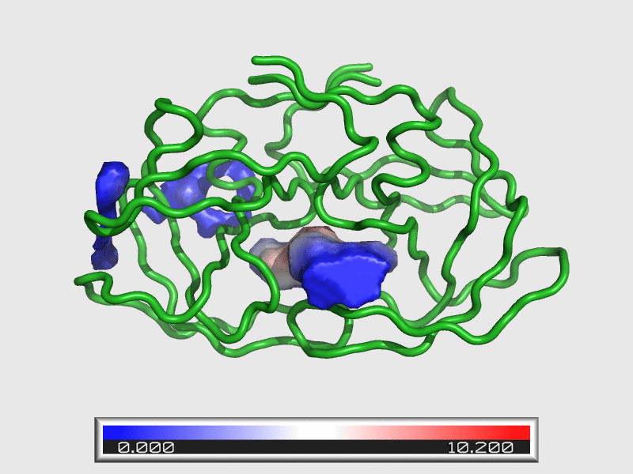
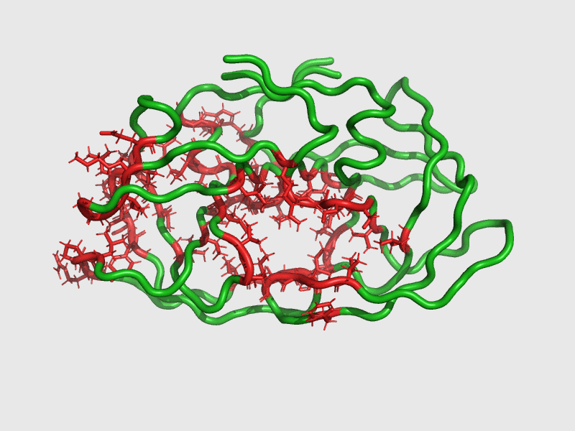
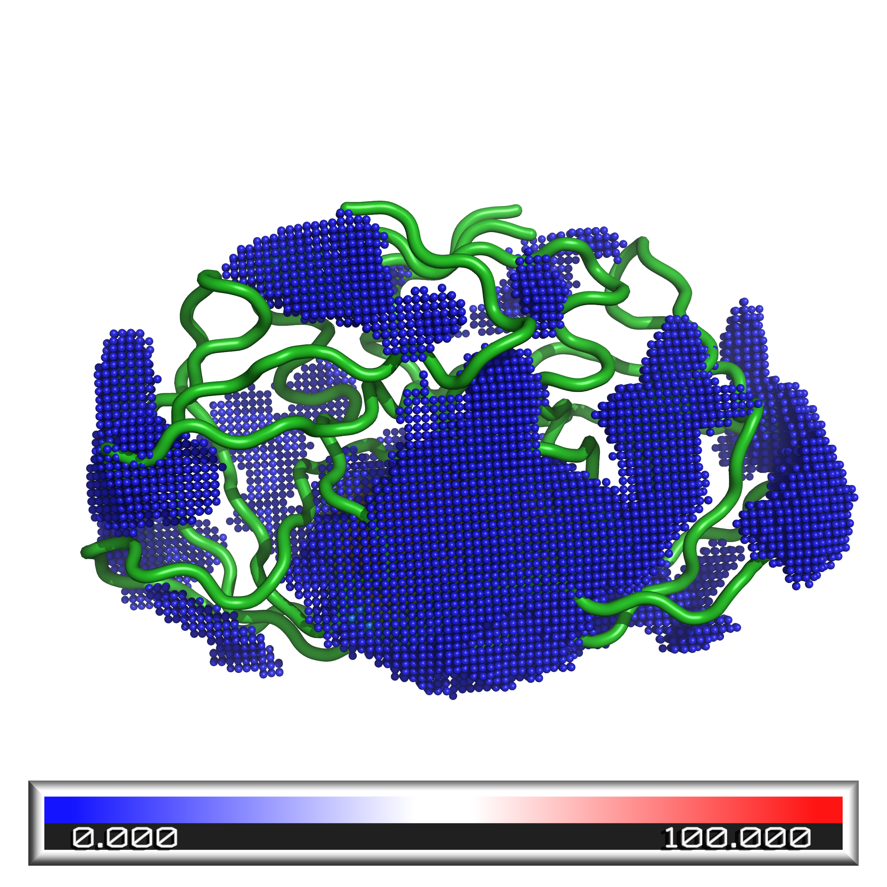
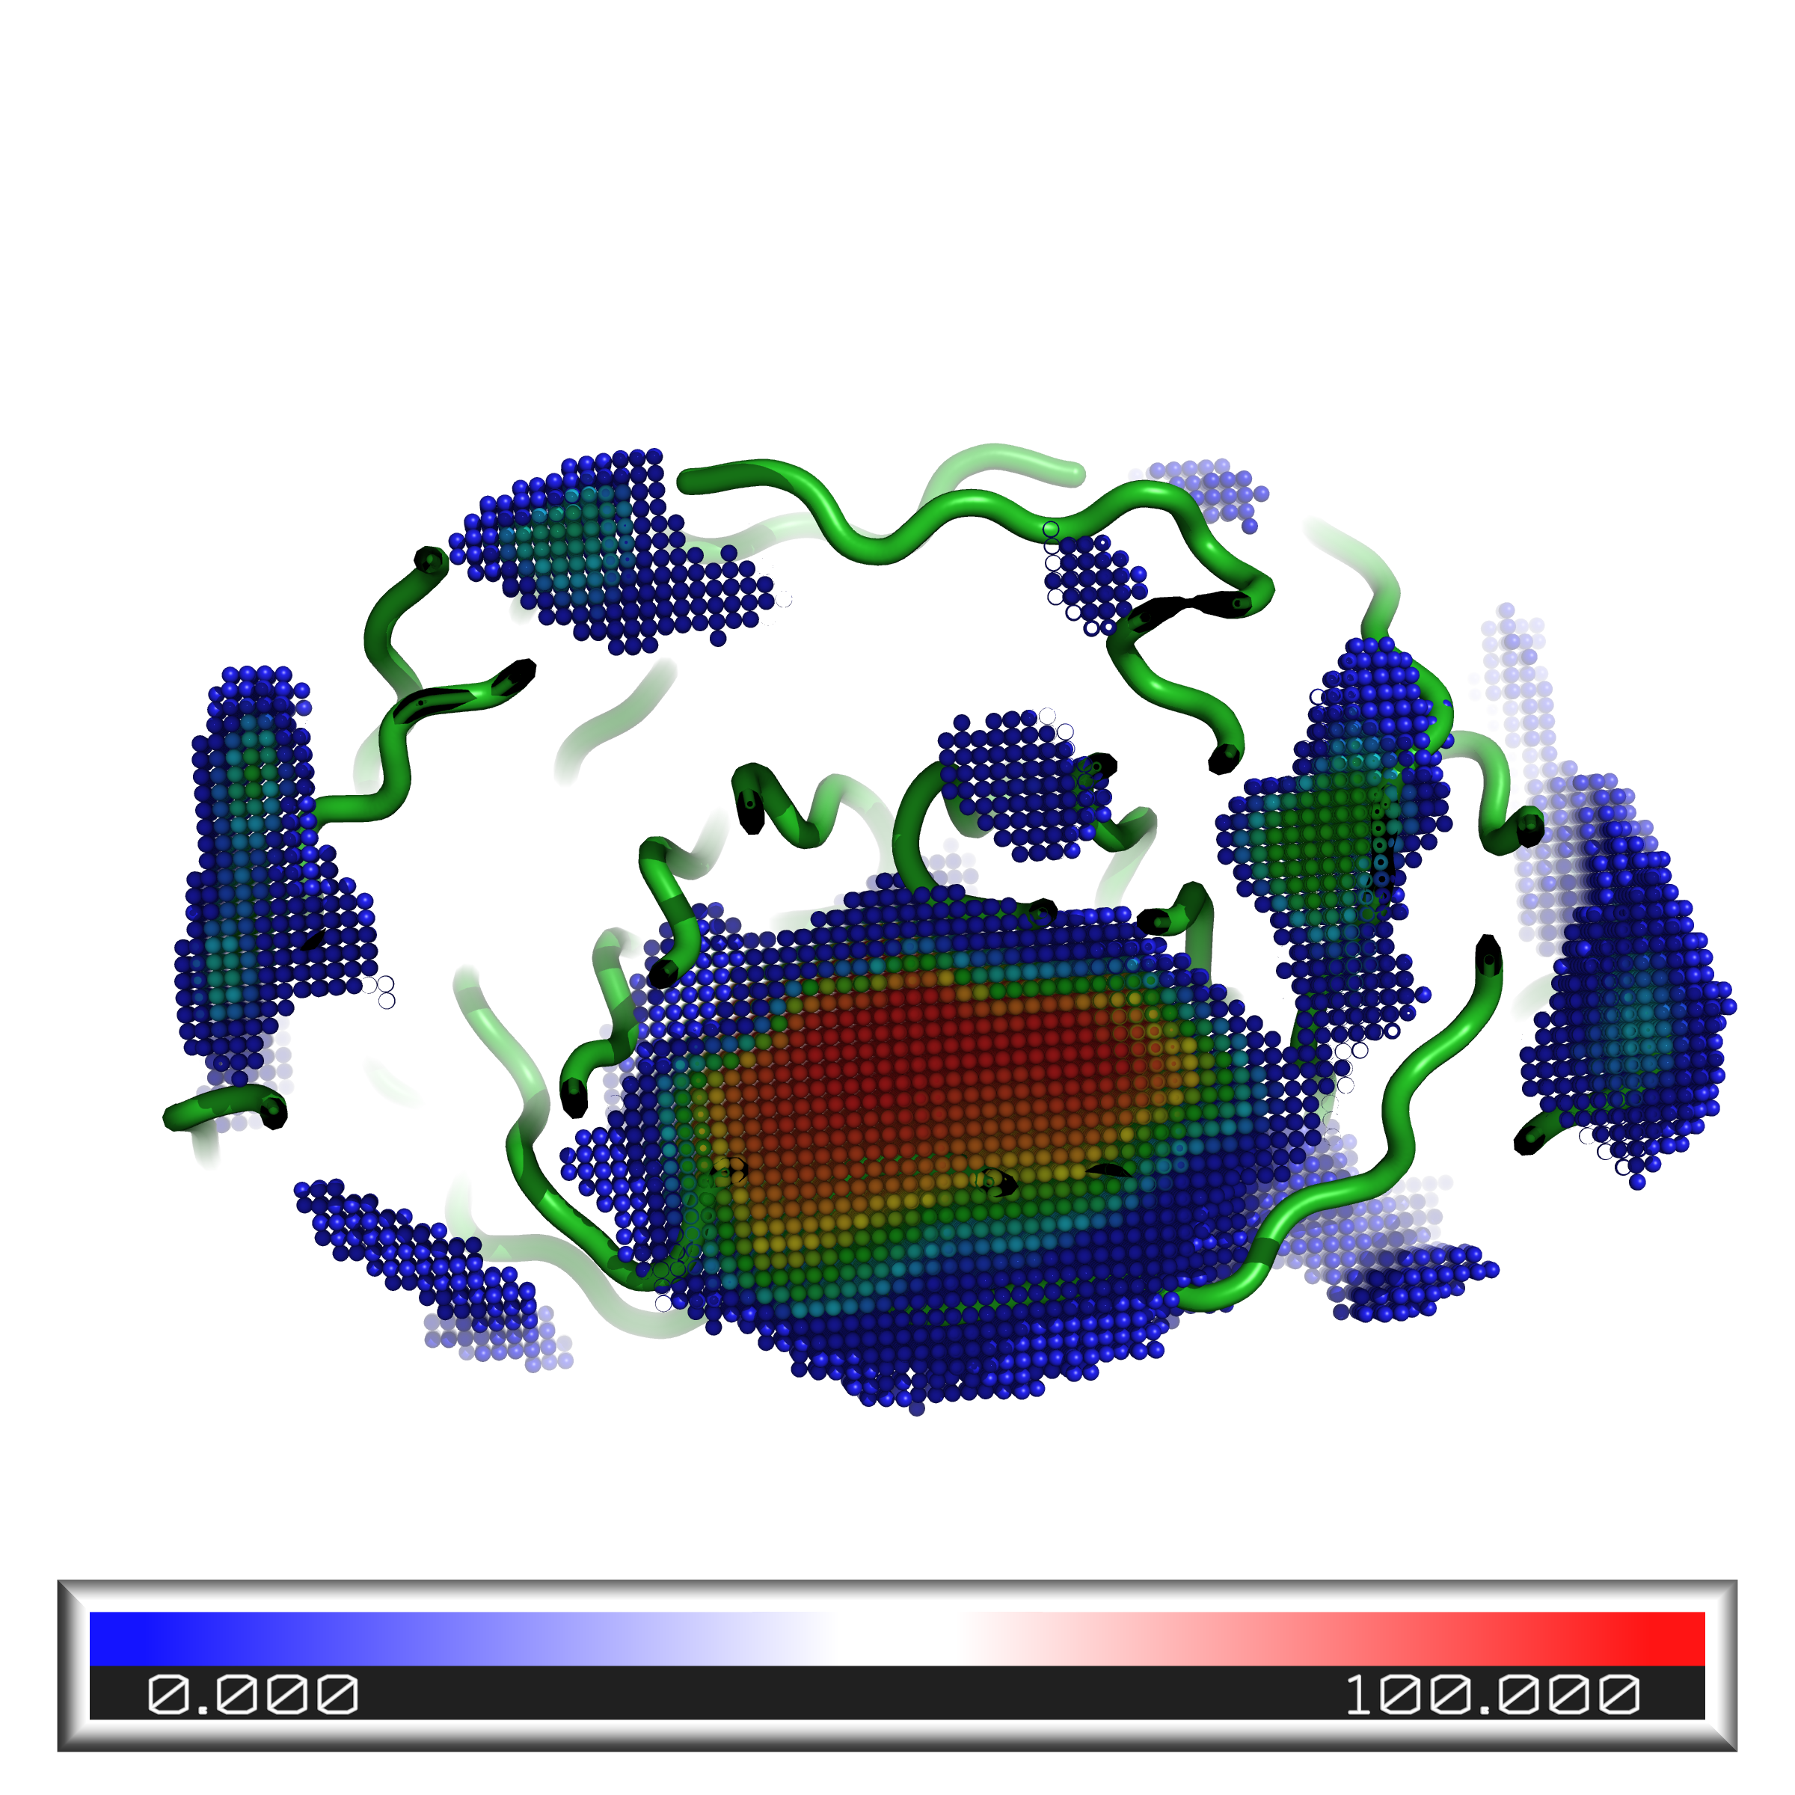
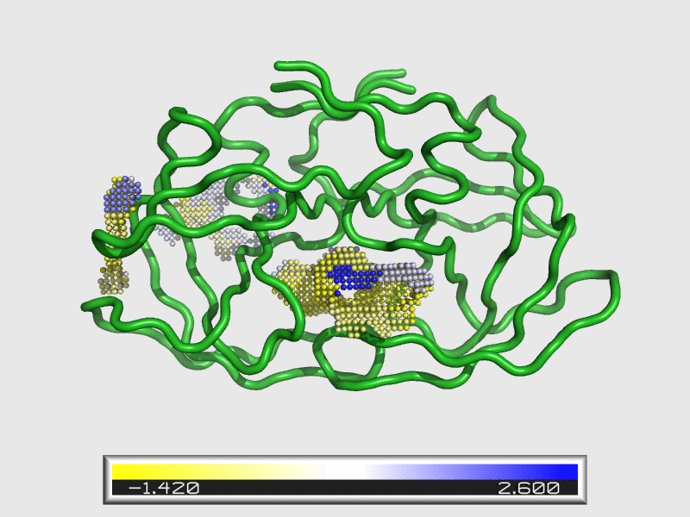
KVFinderMD: a Python package to detect and describe binding sites in molecular dynamics trajectories
Guerra, JVS; Ribeiro-Filho, HV; Bortot, LO; Jara, GE; Pereira, JGC; Lopes-de-Oliveira, PS
KVFinder for Molecular Dynamics analysis (KVFinderMD)
Shape, volume and depth
Interface residues
HIV-1 protease
Surface, area and hydropathy
Spatial conservation (%)
Notes:
Using pyKVFinder, recently developed by our group, as a building block, we developed KVFinder for Molecular Dynamics analysis (KVFinderMD), to explore binding site dynamics in biomolecular structures of interest. Since the intrinsic MD may change characteristics over time, KVFinderMD describe cavities in respect to: shape, volume, area, depth, hydropathy, interface residues and spatial conservation.

Slide 8

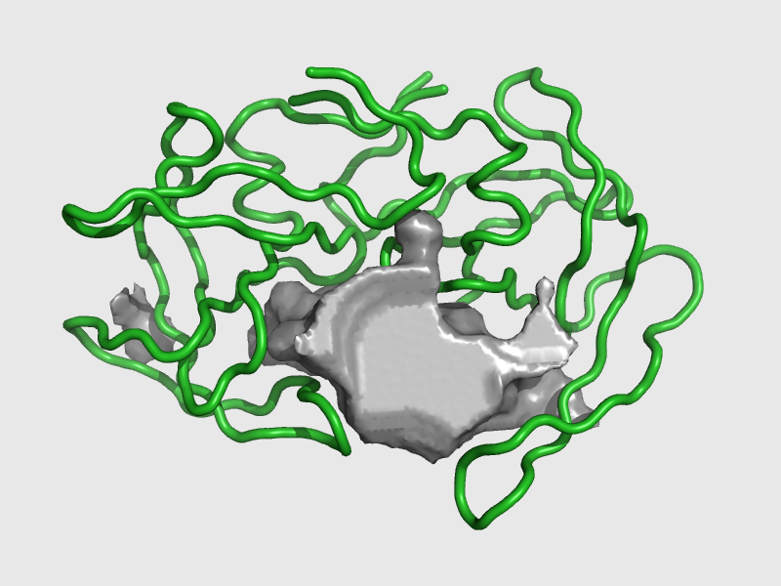
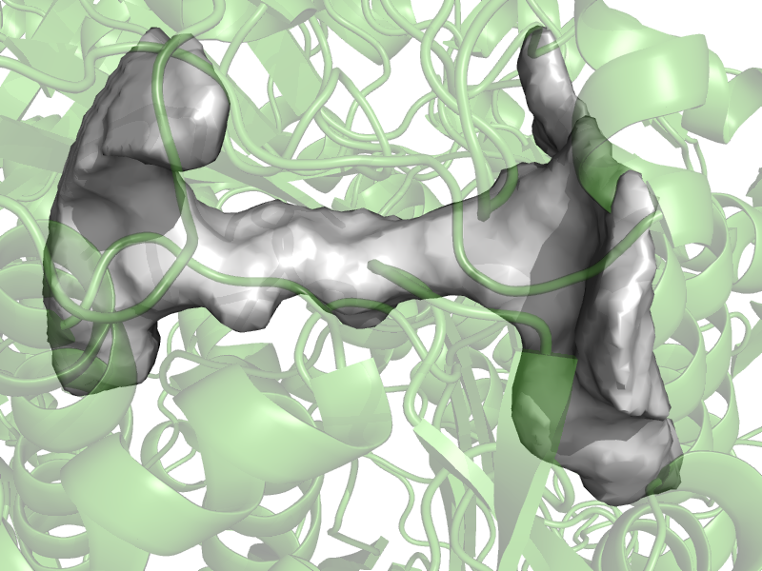
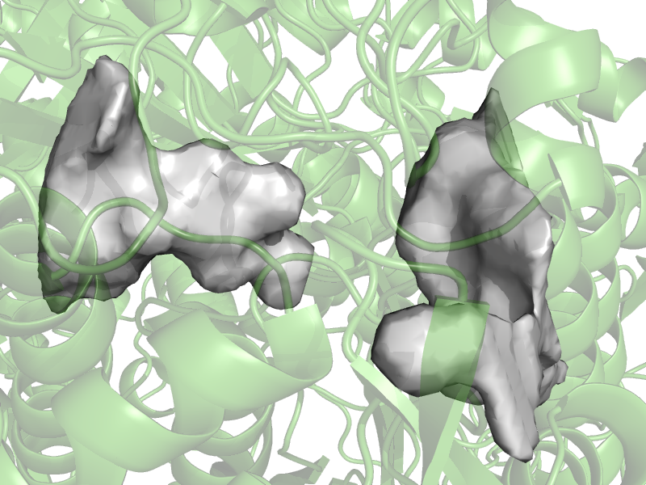
KVFinderMD: a Python package to detect and describe binding sites in molecular dynamics trajectories
Guerra, JVS; Ribeiro-Filho, HV; Bortot, LO; Jara, GE; Pereira, JGC; Lopes-de-Oliveira, PS
Binding site continuity
Shape
Split/Group
Notes:
The protein-ligand and protein-protein interactions rely on the intrinsic dynamics of the target receptor, in which the classical lock and key model fails, and more recent binding models, e.g., induced-fit and conformation selection, thrive. Thus, molecular dynamics simulations are a useful tool to understand the underlying mechanisms of molecular recognition and, ultimately, the biomolecular function.

Slide 9
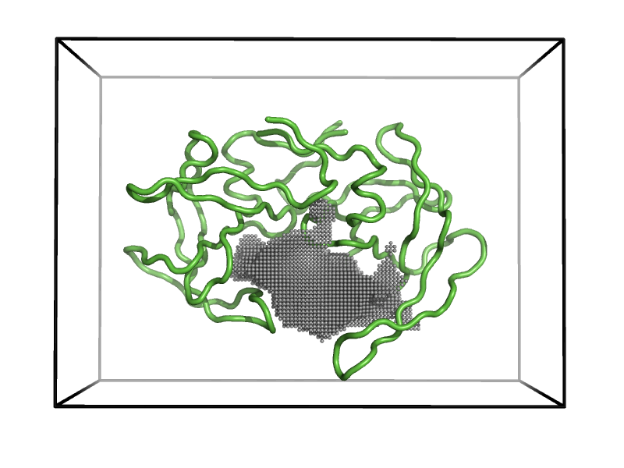
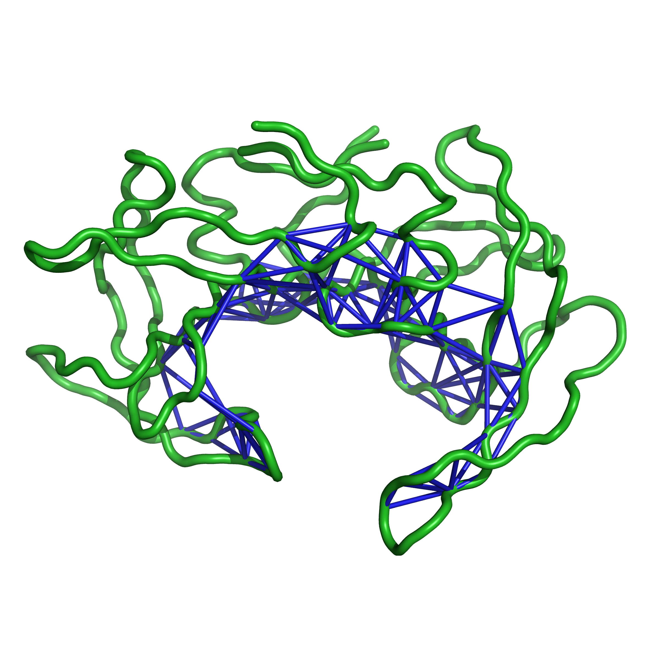
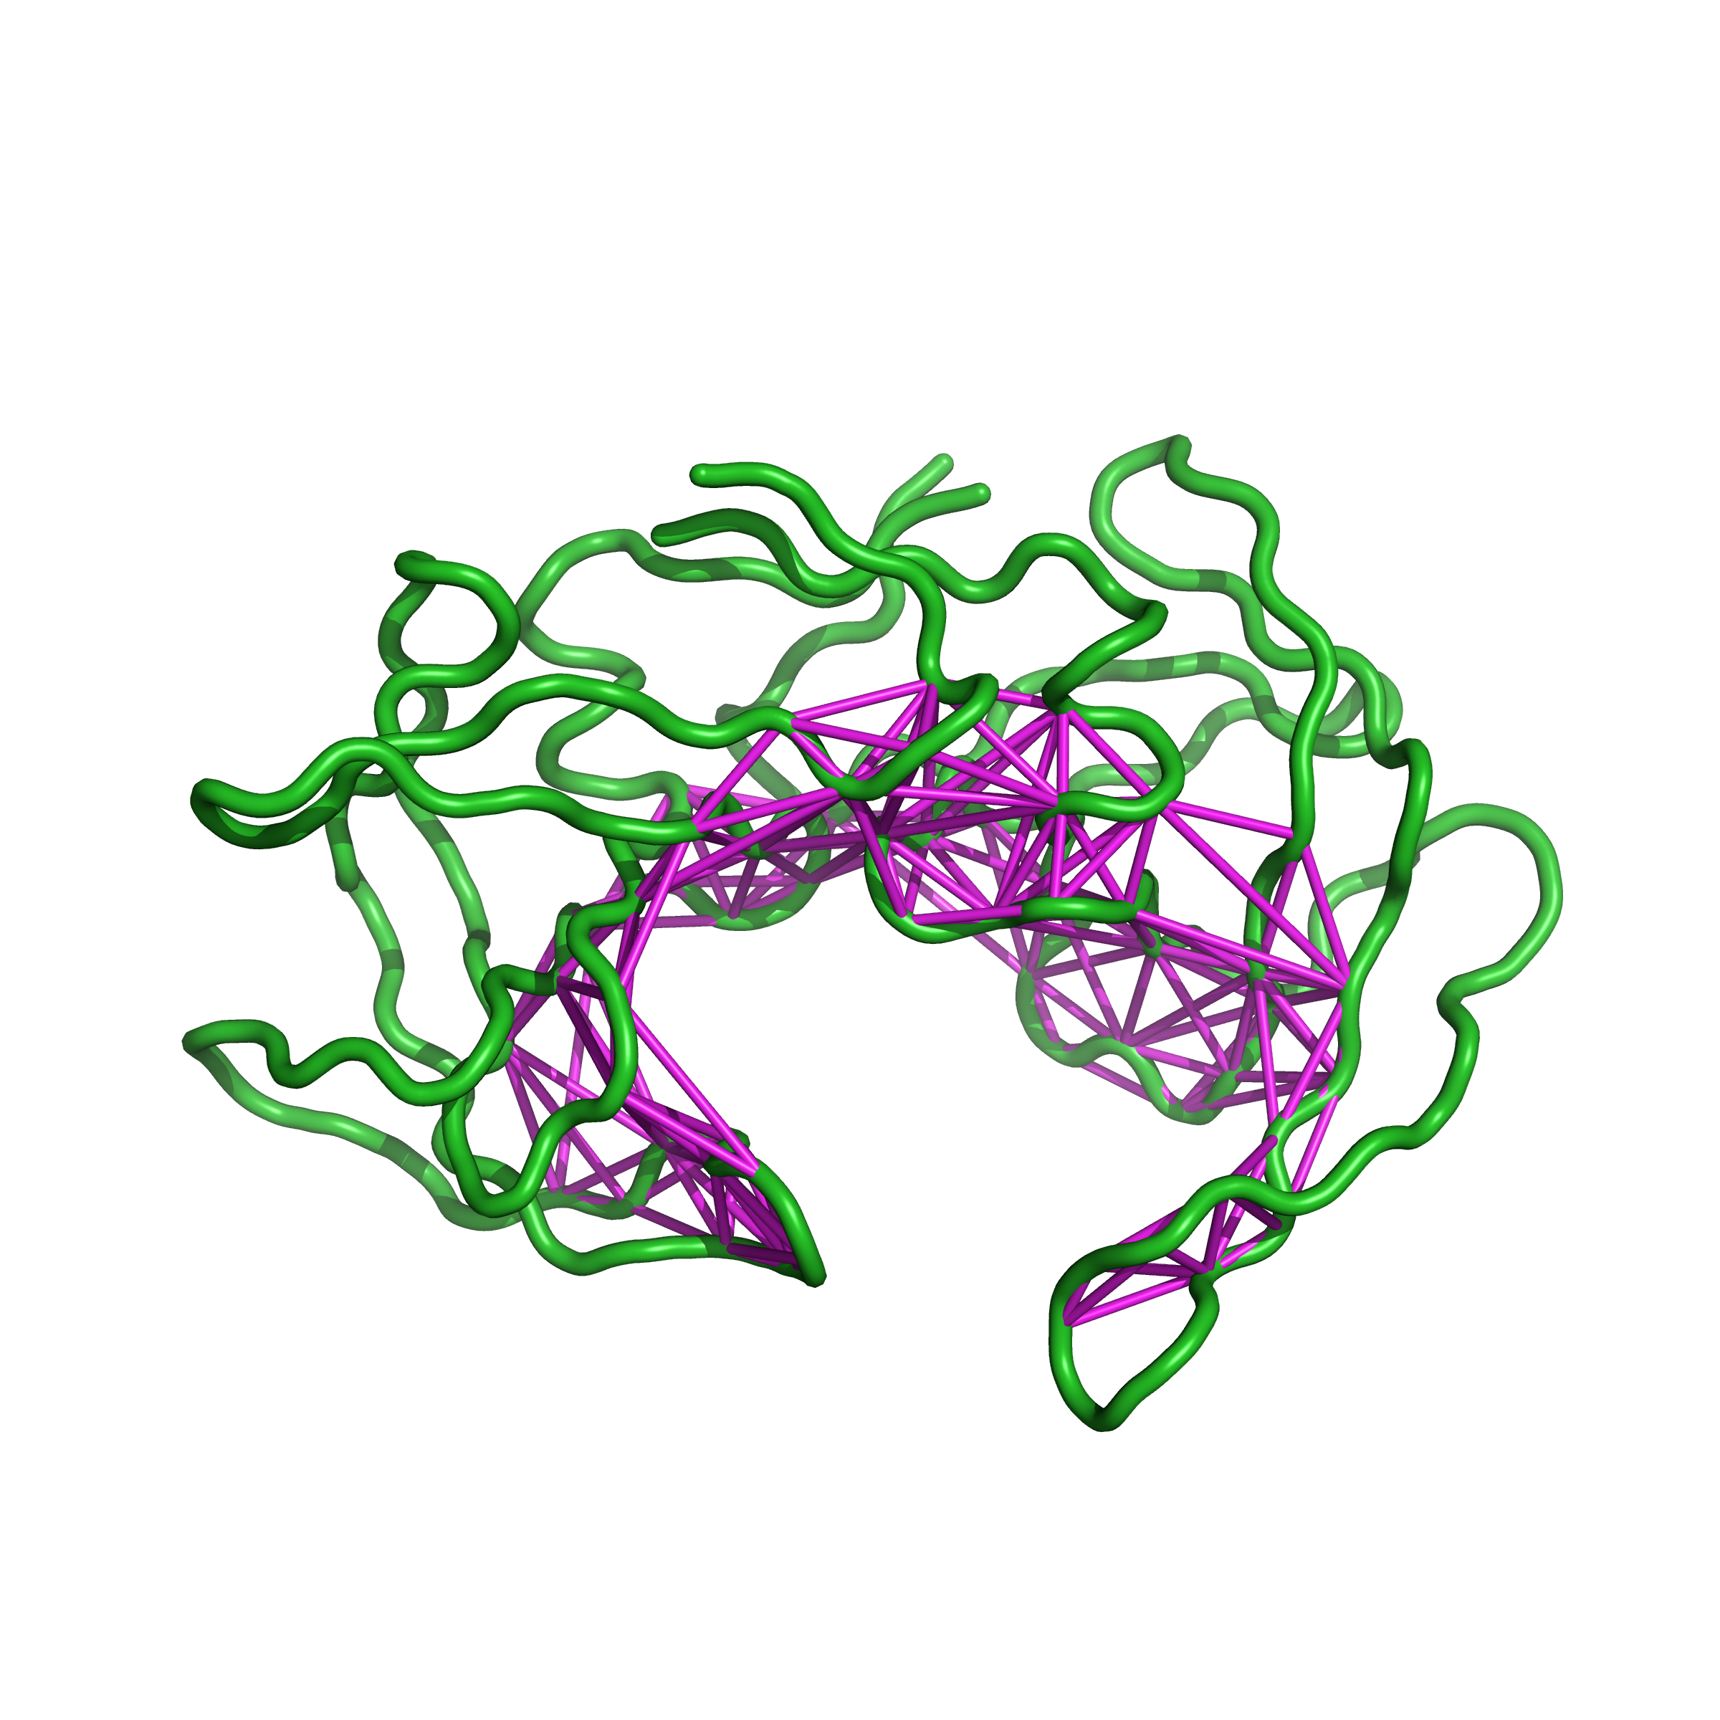
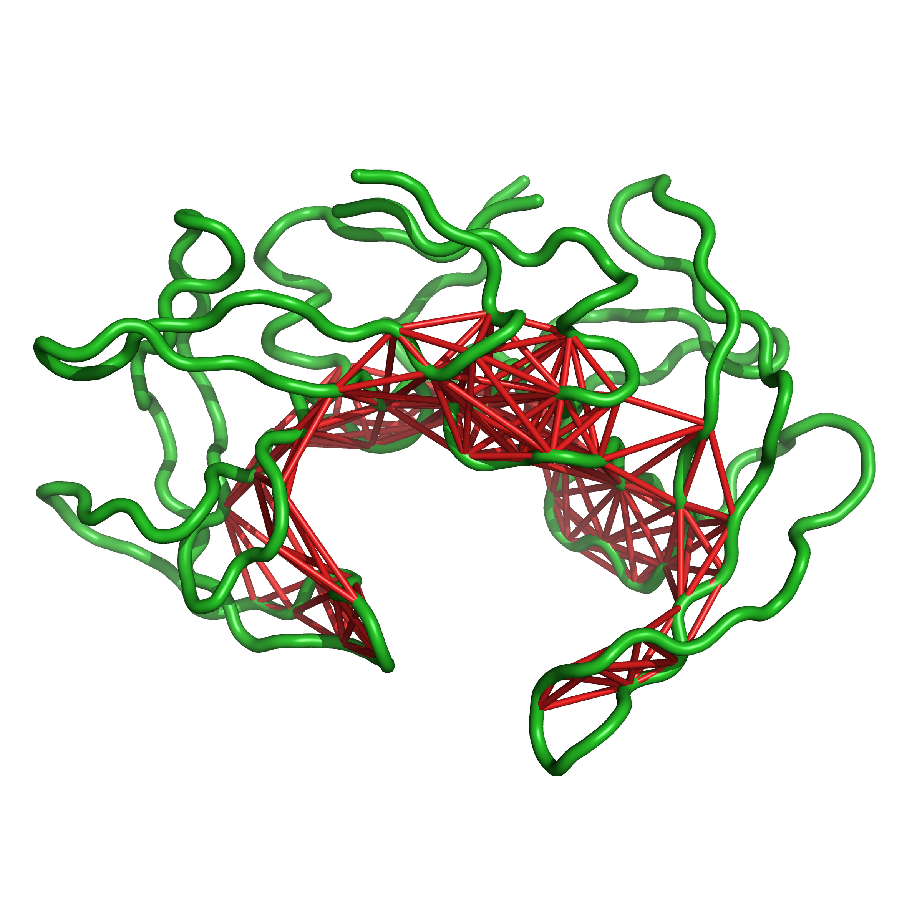
KVFinderMD: a Python package to detect and describe binding sites in molecular dynamics trajectories
Guerra, JVS; Ribeiro-Filho, HV; Bortot, LO; Jara, GE; Pereira, JGC; Lopes-de-Oliveira, PS
Graph-based algorithm to represent cavities
Cβ
Any atom
Cα
Any atom

Slide 10
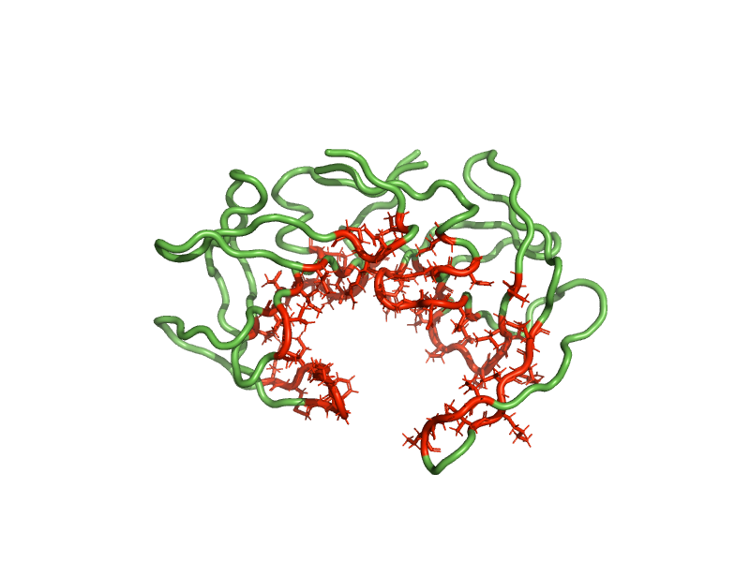
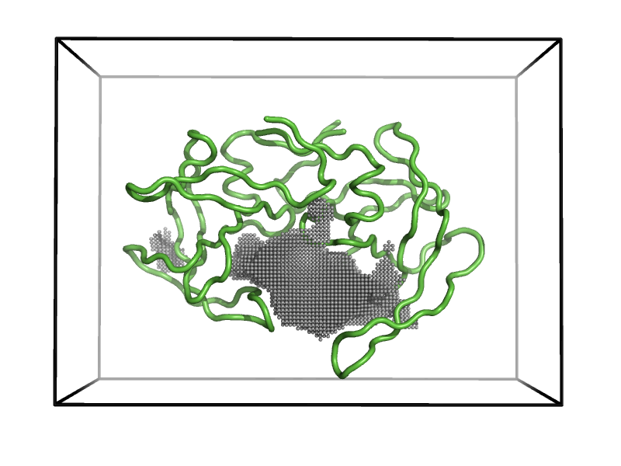
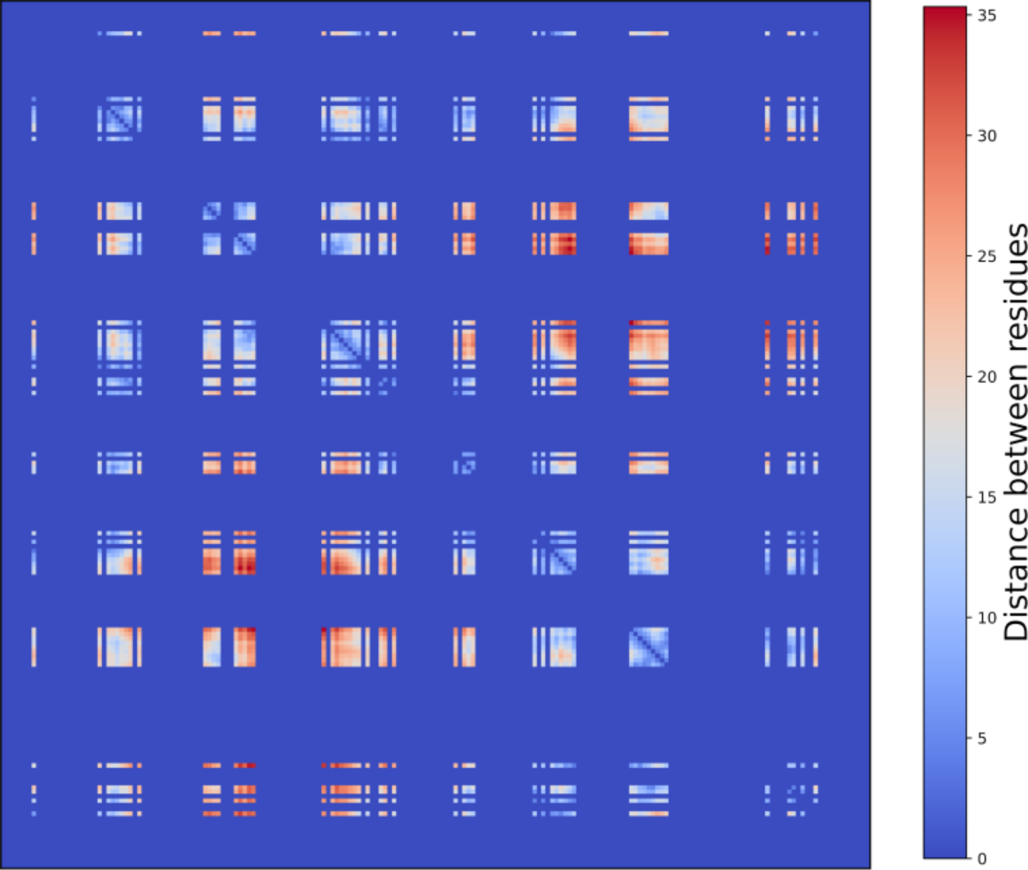
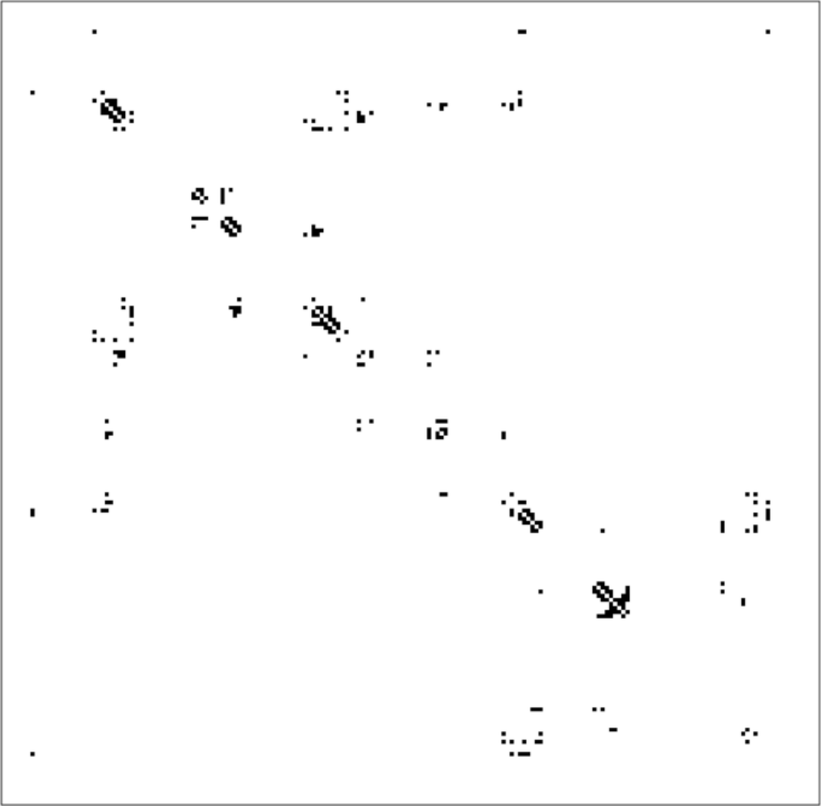
KVFinderMD: a Python package to detect and describe binding sites in molecular dynamics trajectories
Guerra, JVS; Ribeiro-Filho, HV; Bortot, LO; Jara, GE; Pereira, JGC; Lopes-de-Oliveira, PS
Case study: HIV-1 protease
How to measure similarity between cavities?
201 frames
(672 cavities)
Grid representation
Residues representation
Graph representation
Distance matrix
Contact matrix
Structural Cavity Alignment
Notes:
Structural cavity alignment:
1) grid
2) distance map
3) contact map

Slide 11
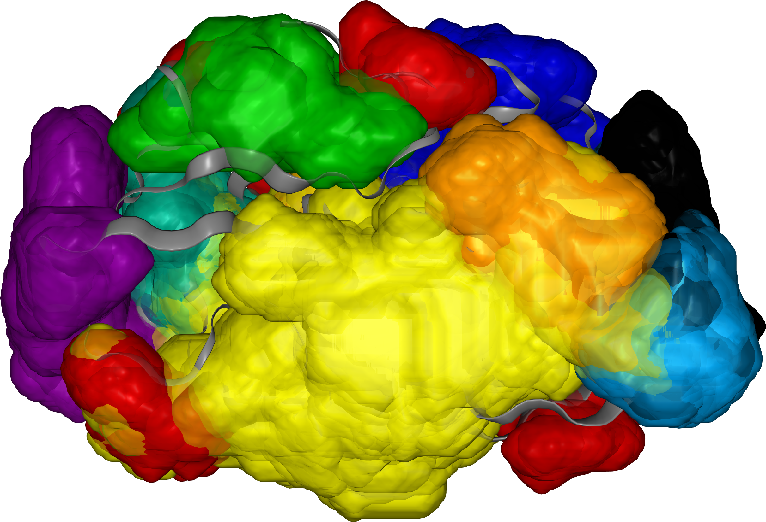
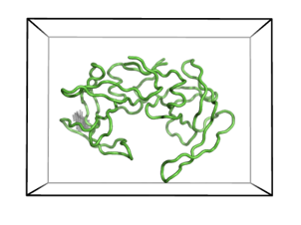
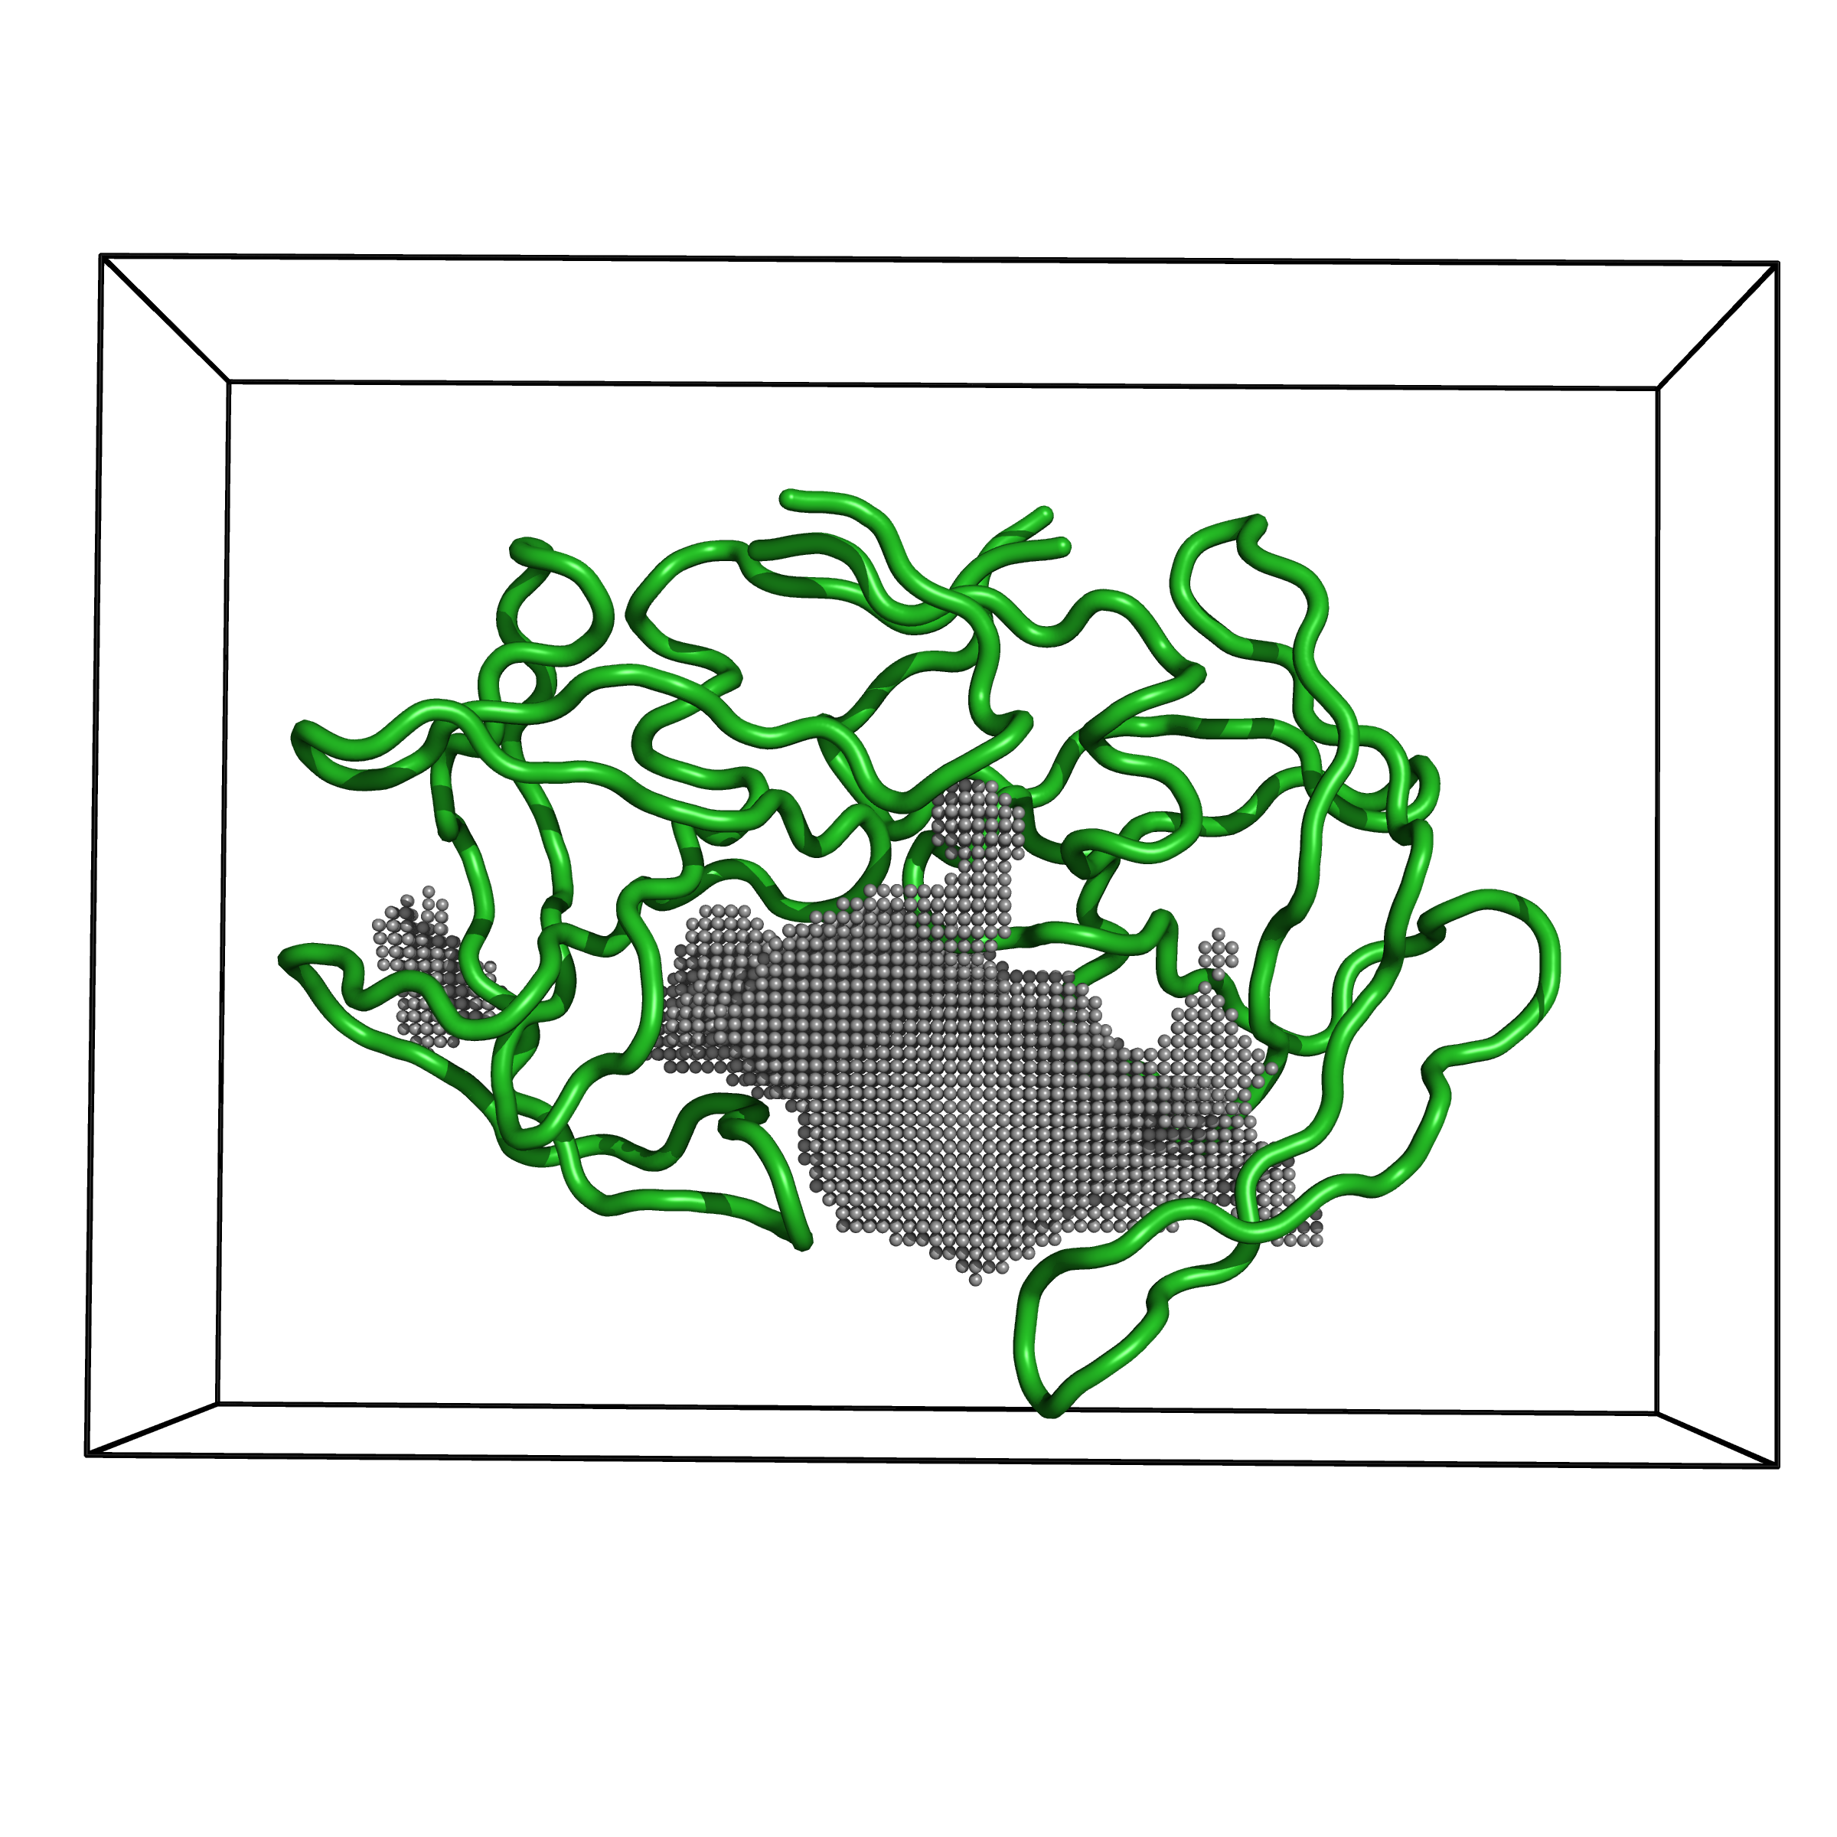
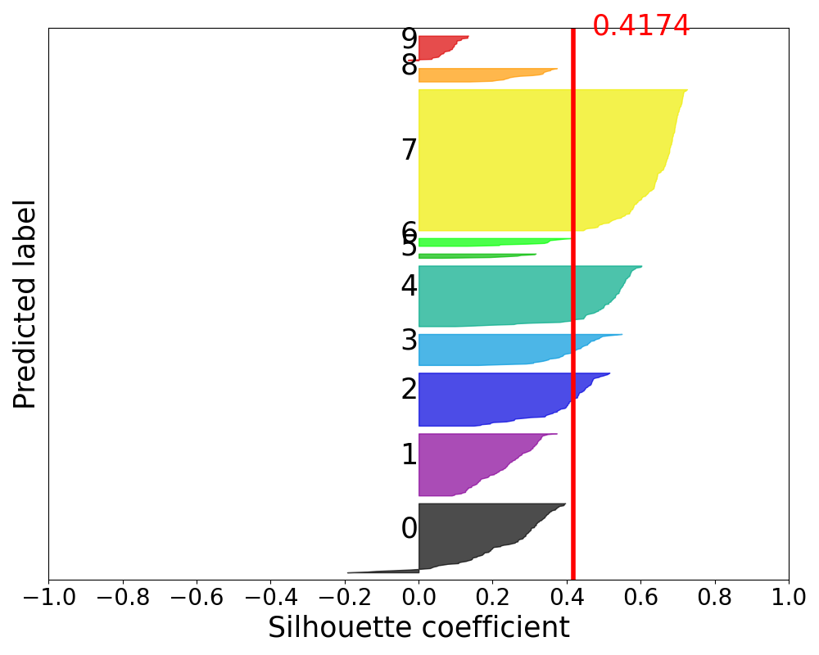
KVFinderMD: a Python package to detect and describe binding sites in molecular dynamics trajectories
Guerra, JVS; Ribeiro-Filho, HV; Bortot, LO; Jara, GE; Pereira, JGC; Lopes-de-Oliveira, PS
Case study: HIV-1 protease
Structural cavity alignment: Grid alignment
Silhouette Score: 0.4174
N = 10 clusters
Clustering (Corr.)
672 grids
(201 frames)
.
.
.
Input size = 160 * 126 * 105
= 2.1 * 10⁶ voxels
Notes:
Explain how KVFinder dual probe system works.

Slide 12
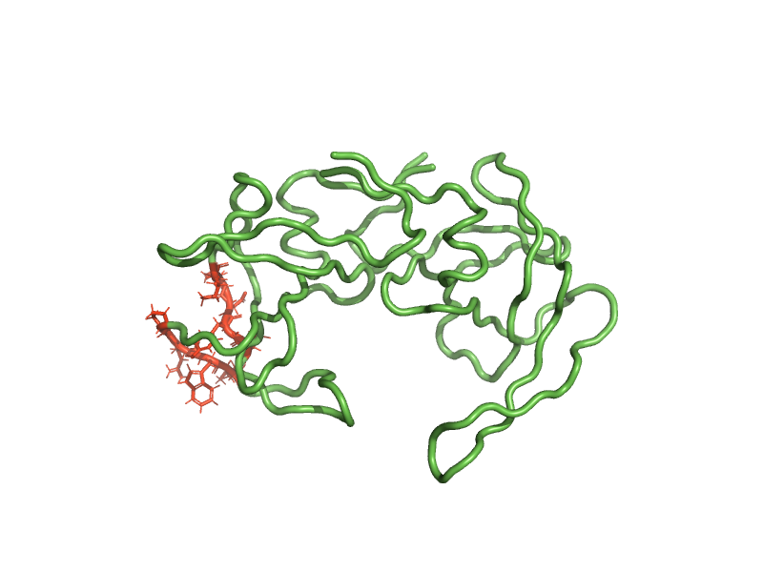
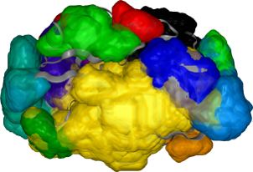
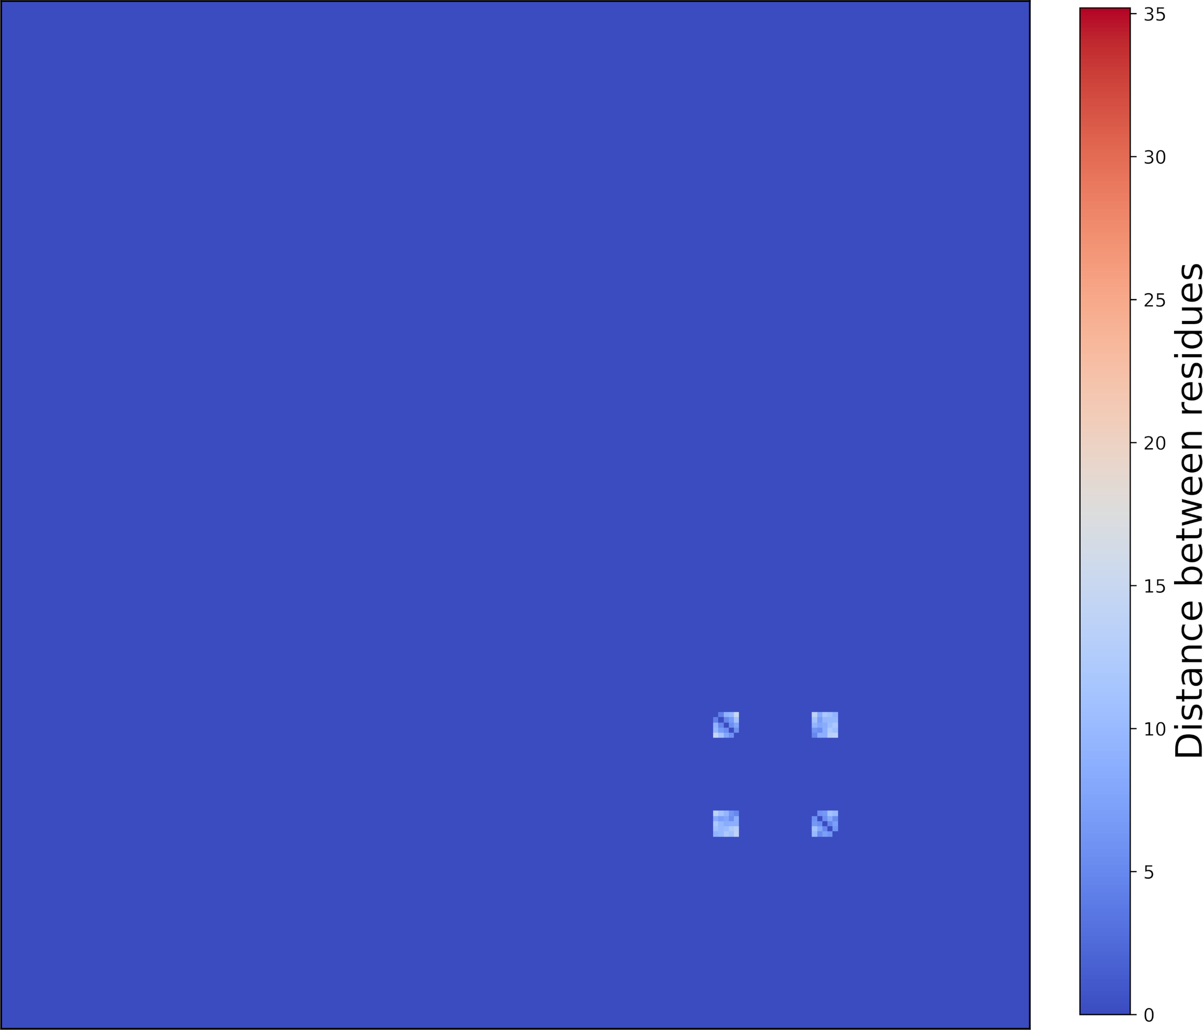
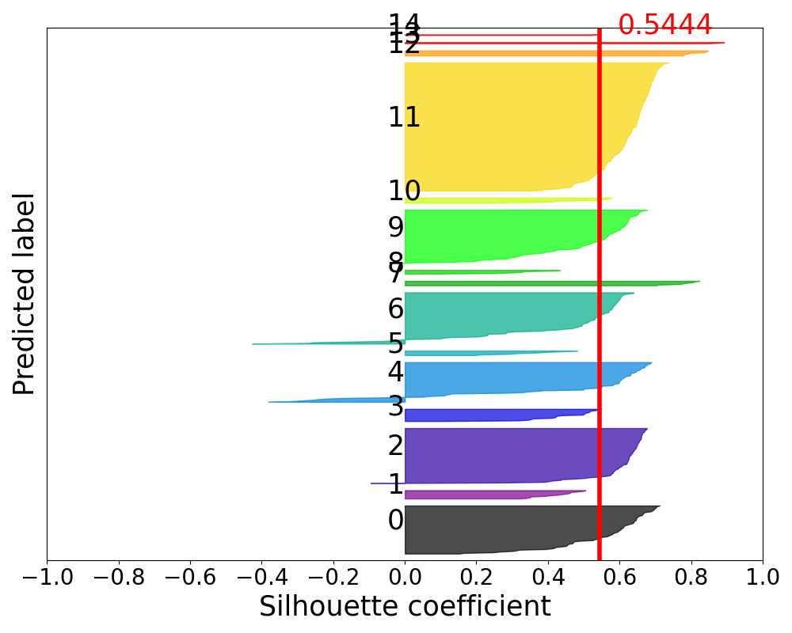
KVFinderMD: a Python package to detect and describe binding sites in molecular dynamics trajectories
Guerra, JVS; Ribeiro-Filho, HV; Bortot, LO; Jara, GE; Pereira, JGC; Lopes-de-Oliveira, PS
Case study: HIV-1 protease
Structural cavity alignment: Distance matrix alignment
Silhouette Score: 0.5444
N = 15 clusters
Clustering (Cosine)
672 distance maps
(201 frames)
.
.
.
Numeric array
Input size = 198 * 198
= 3.9 * 10⁴ pixels
Notes:
Distance map alignment is inspired in DALI alignment.

Slide 13
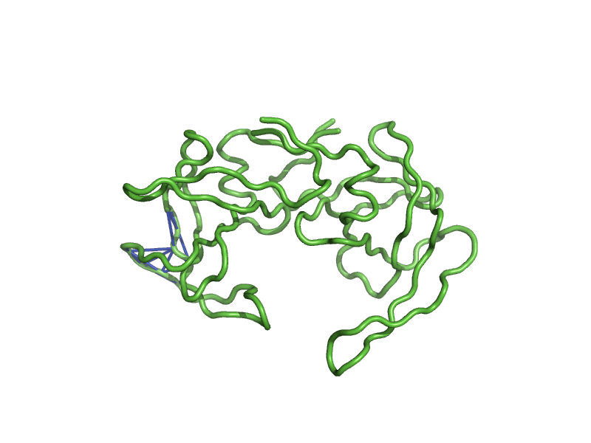
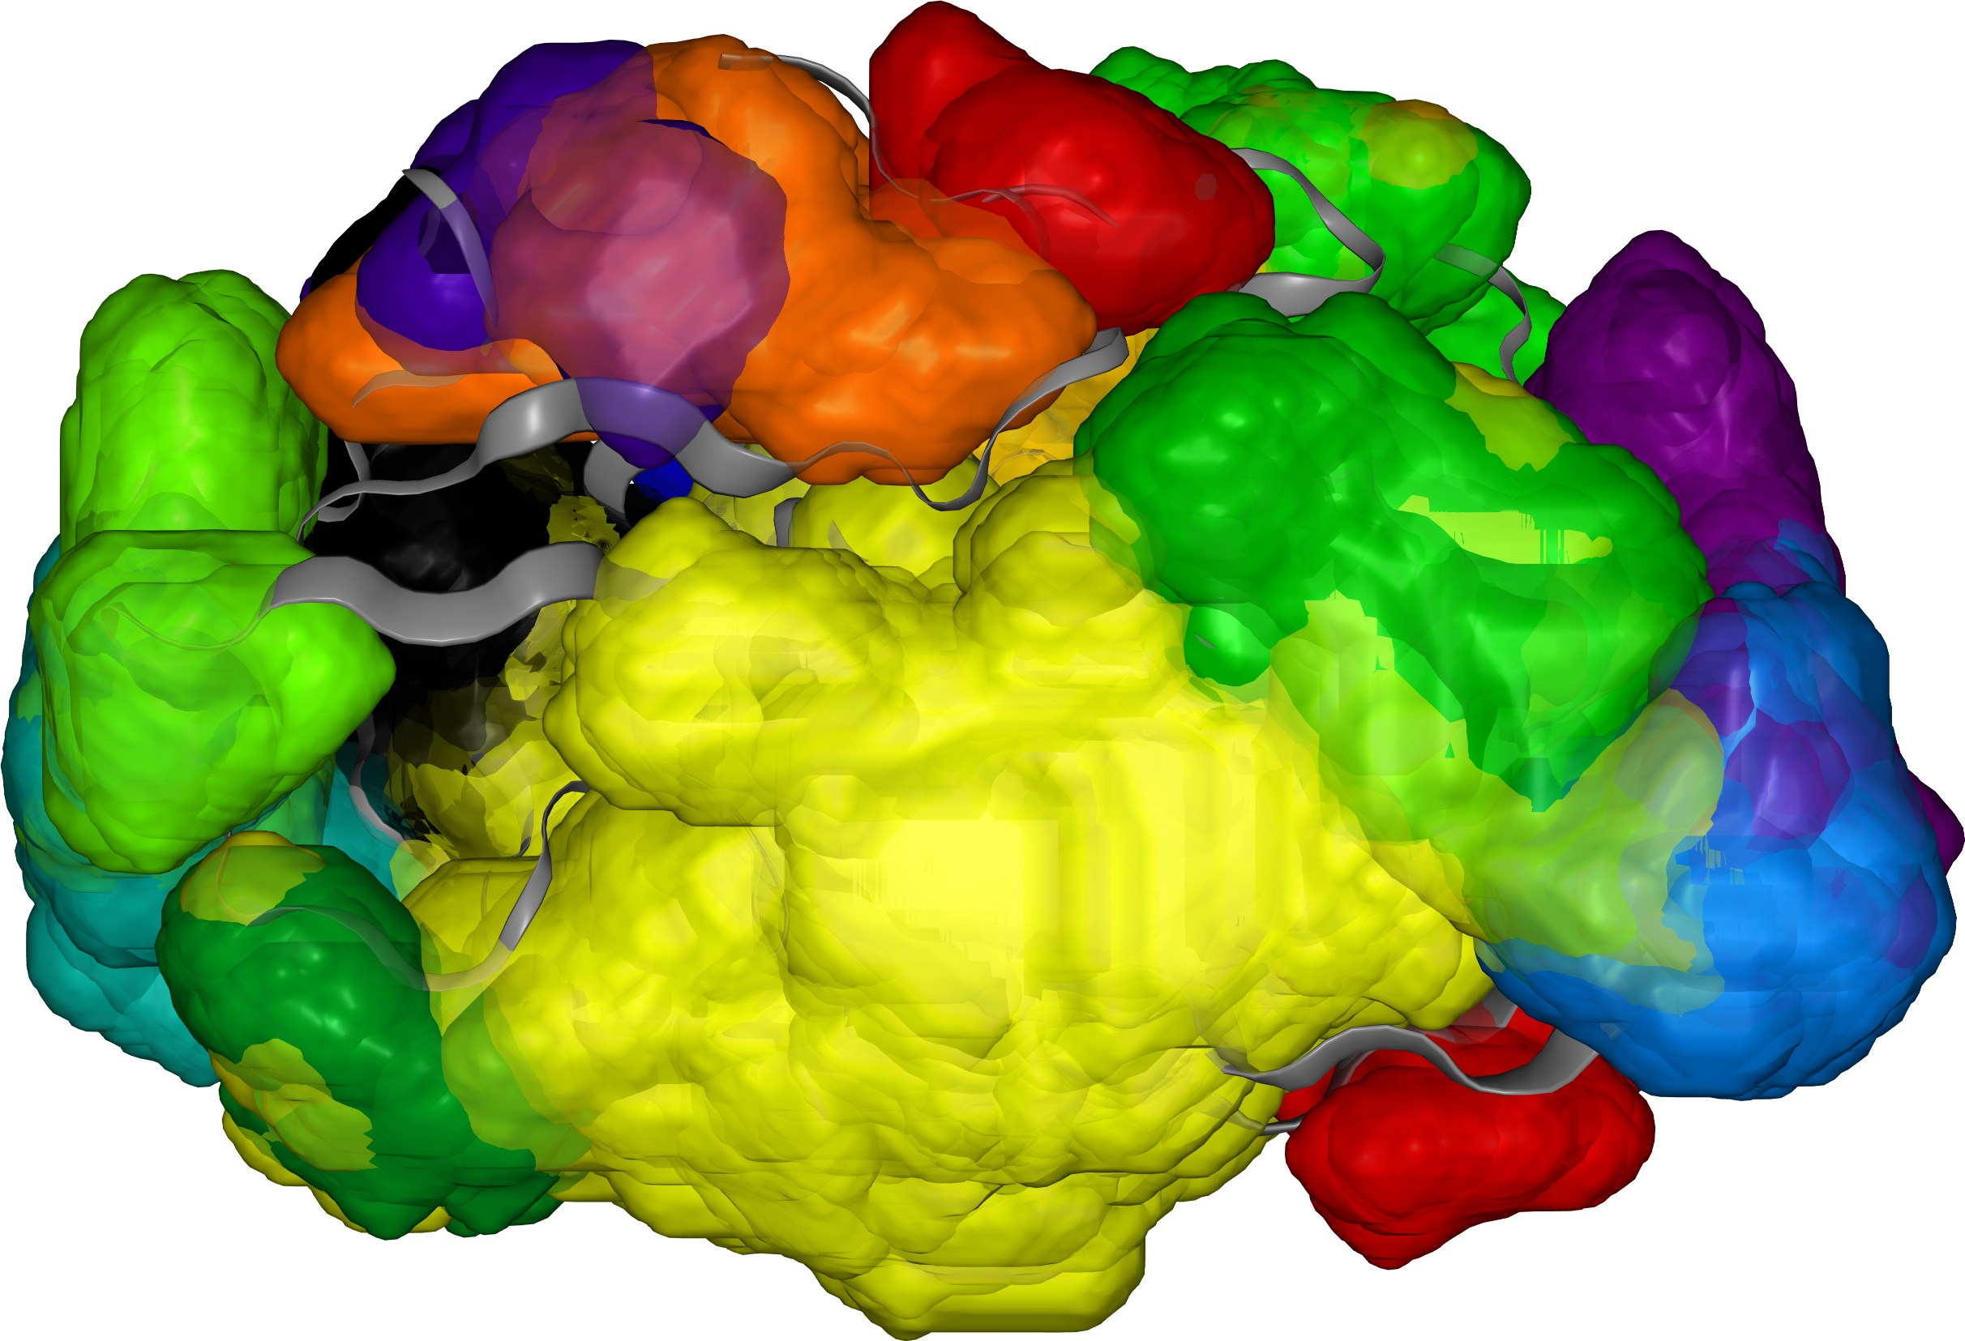
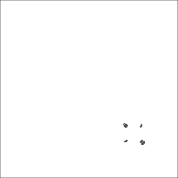
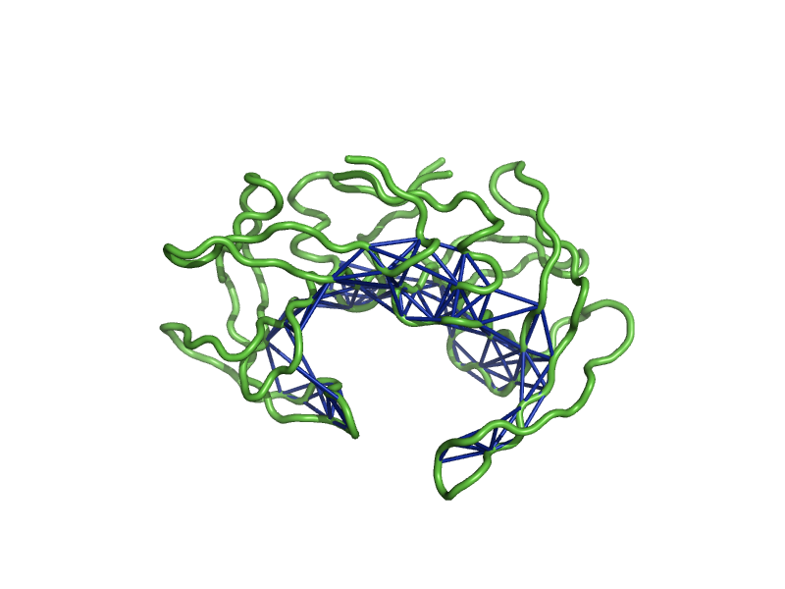
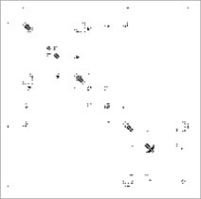
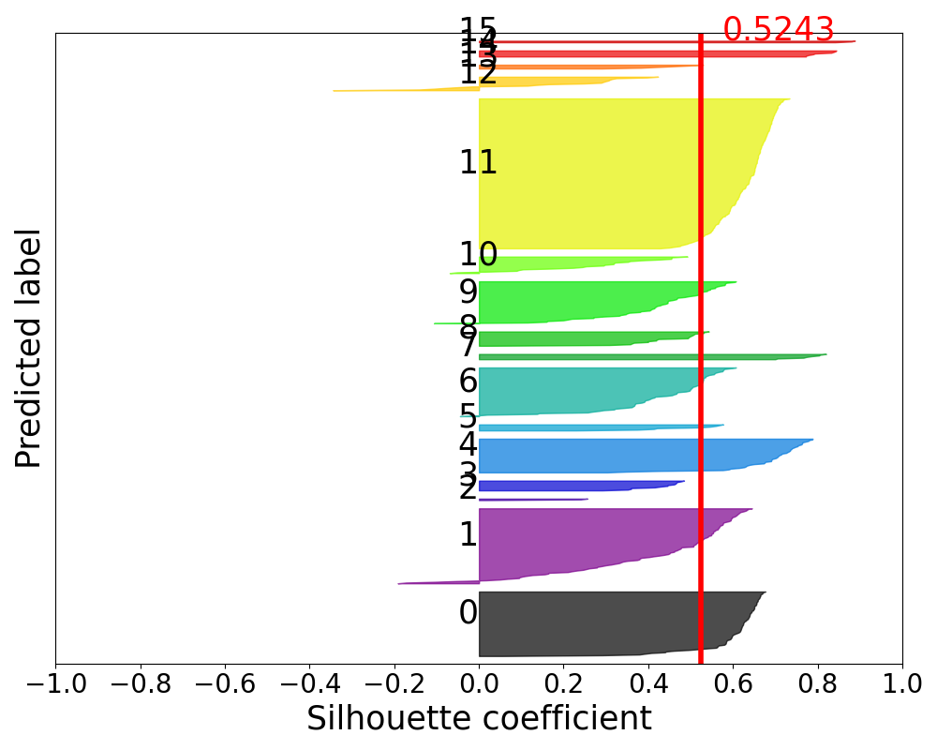
KVFinderMD: a Python package to detect and describe binding sites in molecular dynamics trajectories
Guerra, JVS; Ribeiro-Filho, HV; Bortot, LO; Jara, GE; Pereira, JGC; Lopes-de-Oliveira, PS
Case study: HIV-1 protease
Structural cavity alignment: Contact matrix alignment
Silhouette Score: 0.5243
N = 16 clusters
Clustering (Dice)
672 contact maps
(201 frames)
.
.
.
Boolean array
Input size = 198 * 198
= 3.9 * 10⁴ pixels
Notes:
Explain how KVFinder dual probe system works.

Slide 14
KVFinderMD: a Python package to detect and describe binding sites in molecular dynamics trajectories
Guerra, JVS; Ribeiro-Filho, HV; Bortot, LO; Jara, GE; Pereira, JGC; Lopes-de-Oliveira, PS
Case study: HIV-1 protease
Structural cavity alignment
 | Grid alignment | Distance alignment | Contact alignment
Number of clusters | 10 | 15 | 16
Data size | ~10⁶ | ~10⁴ | ~10⁴
Notes:
Explain how KVFinder dual probe system works.

Slide 15



KVFinderMD: a Python package to detect and describe binding sites in molecular dynamics trajectories
Guerra, JVS; Ribeiro-Filho, HV; Bortot, LO; Jara, GE; Pereira, JGC; Lopes-de-Oliveira, PS
Thank you!
LBC Team
Paulo Sergio Lopes-de-Oliveira
Helder Veras Ribeiro-Filho
José Geraldo de Carvalho Pereira
Leandro Oliveira Bortot
Gabriel Ernesto Jara
Luiz Fernando Giolo Alves
Mario Luis Chiparini Neto
2018/00629-0
350244/2020-0
Notes:
Explain how KVFinder dual probe system works.

Slide 17
KVFinderMD: a Python package to detect and describe binding sites in molecular dynamics trajectories
Guerra, JVS; Ribeiro-Filho, HV; Bortot, LO; Jara, GE; Pereira, JGC; Lopes-de-Oliveira, PS
Contact maps (boolean)
Dice
Hamming
Jaccard
Kulsinki
Rogers-Tanimoto
Russel-Rao
Sokal-Michener
Sokal-Sneath
Yule
Distance matrices (numeric)
Braycurtis
Canberra
Chebyshev
City Block (Manhattan)
Jensen-Shannon
Squared Euclidean
Notes:
Explain how KVFinder dual probe system works.

Slide 18
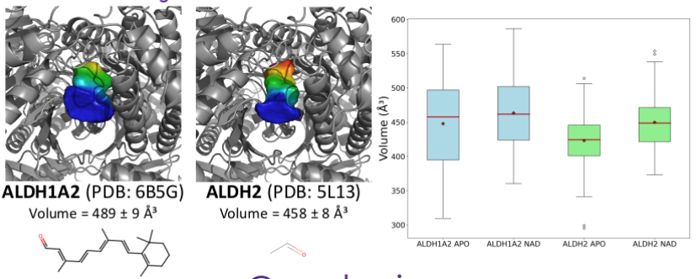
KVFinderMD: a Python package to detect and describe binding sites in molecular dynamics trajectories
Guerra, JVS; Ribeiro-Filho, HV; Bortot, LO; Jara, GE; Pereira, JGC; Lopes-de-Oliveira, PS
Case study II: ALDH1A2 vs ALDH2
Notes:
Explain how KVFinder dual probe system works.

Slide 19
KVFinderMD: a Python package to detect and describe binding sites in molecular dynamics trajectories
Guerra, JVS; Ribeiro-Filho, HV; Bortot, LO; Jara, GE; Pereira, JGC; Lopes-de-Oliveira, PS
Case study II: ALDH1A2 vs ALDH2
ALDH2: deep and narrower site -> acetaldehyde preference
ALDH1: deep and wider site -> branched aldehyde preference
Yin, SJ., Wang, MF., Han, CL., Wang, SL. (1995). Substrate Binding Pocket Structure of Human Aldehyde Dehydrogenases. In: Weiner, H., Holmes, R.S., Wermuth, B. (eds) Enzymology and Molecular Biology of Carbonyl Metabolism 5. Advances in Experimental Medicine and Biology, vol 372. Springer, Boston, MA. https://doi-org.ez106.periodicos.capes.gov.br/10.1007/978-1-4615-1965-2_2
ALDH1A2: Retinal preference
ALDH2: Acetaldehyde preference
Chen, C. H., Ferreira, J. C., Gross, E. R., & Mochly-Rosen, D. (2014). Targeting aldehyde dehydrogenase 2: new therapeutic opportunities. Physiological reviews, 94(1), 1–34. https://doi.org/10.1152/physrev.00017.2013
Notes:
Explain how KVFinder dual probe system works.

